Slide 1

Support Vector Classification
Model 2, 3

Slide 2
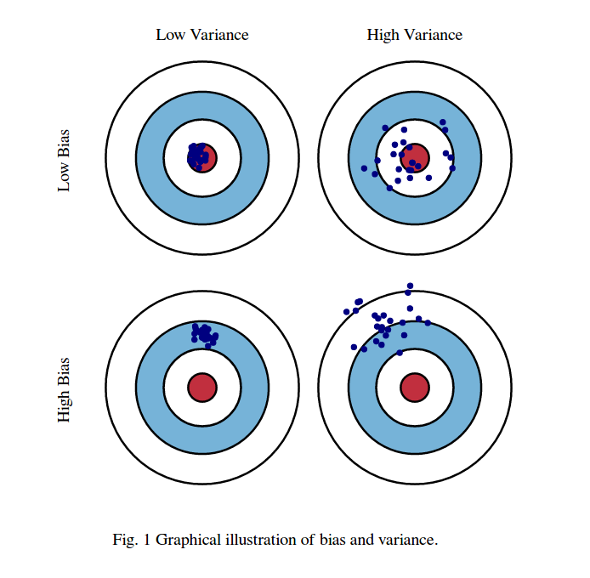
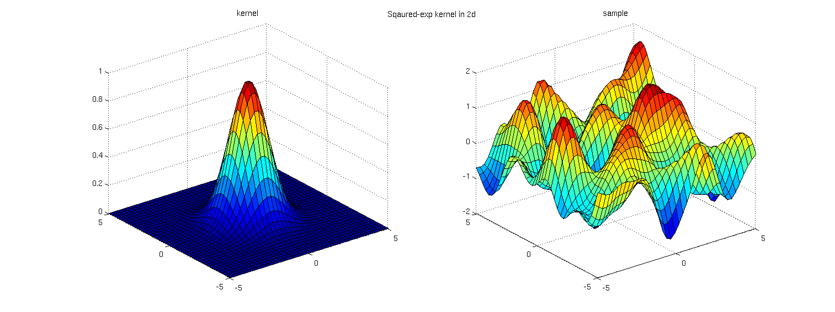
WHAT DO WE WANT?

Slide 3
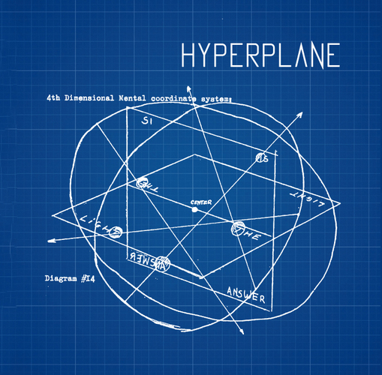
sklearn.svm.SVC
Support Vector Classifier (aka SVC)
  Fit the data, returning a “best fit” hyperplane that divides/categorizes, the data.
0
X_test
1

Slide 4
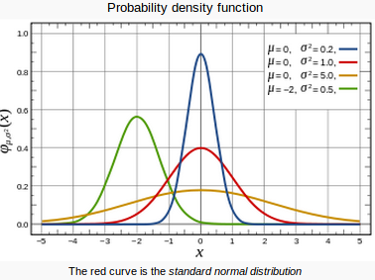
sklearn.svm.SVC
Radial basis function as the kernel
  Gaussian kernel (aka bell-curve)
  No-man’s land between different classes is created with a Gaussian function
  Less tunable
  Basically, linear interpolation

Slide 5
sklearn.svm.SVC

Slide 6
sklearn.svm.SVC
Multi-Class Classification
  One-Against-One
    n_class = # of classes ➔ n_class * (n_class-1)/2 classifiers
    Each classifier trains data from two classes

Slide 7
sklearn.svm.LinearSVC
Linear kernel
  a=b1+b2⋅X+b3⋅X2+b4⋅X3
Scales better to large numbers of samples
Supports dense and sparse input

Slide 8
sklearn.svm.LinearSVC
Multi-Class Classification
  One-Vs-the-Rest
    One classifier/class
    For each classifier, class is fitted against all other classes
    n_classes classifiers

